Slide 1
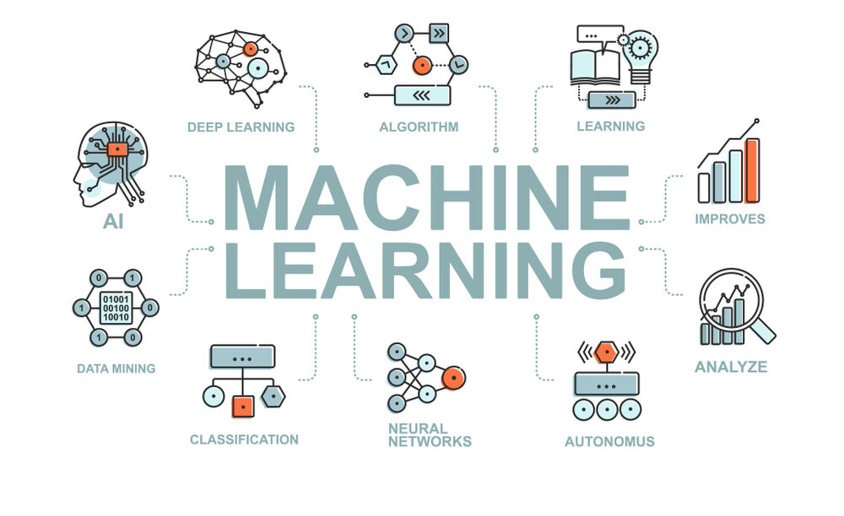
Machine Learning-Based Short-Term Forecasting of Orange and Cotton Crop Prices in Context of Indian Market
Title :-
Group members (B1):
NEHA THAKUR
GEETIKA MAHANT
SUSRUT PATOLE
HUMANSHU GAJBHIYE
Project Guide :
Dr . NILESHSINGH V. THAKUR
Project Co-Ordinator :
Mrs . Smita R. Kapse

Slide 2
Contents :
Problem Definition
Introduction
Objectives
Literature Survey
Broadview of Project (Forecasting Techniques)
Scope
Expected Input and Output
Software Requirements
References

Slide 3
Problem Definition :
Machine Learning-Based Short-Term Forecasting of Orange and Cotton Crop Prices in Context of Indian Market
In this mini project proposal, aim is to build a Machine Learning-based model for the short-term forecasting of orange and cotton crop prices in context of Indian market. For this purpose we will use the existing dataset available at India Government. Firstly, we will explore the exploratory data analysis to take care of missing data and to identify the patterns, if any. Later, we will devise the mechanism to select the number of data records from training, testing and validation point of view. Once, it is finalized then we will explore the different training and learning algorithms for the building of machine learning-based model. To compare the results, we will also implement the ARIMA model.

Slide 4
Introduction :
In India, where agriculture is the foundation of the economy, farmers' livelihoods are greatly impacted by the pricing of crops like cotton and oranges.
India is one of the largest producers and exporters of cotton and oranges in the world.
These crops' prices are frequently unstable and change depending on a number of variables, including the weather, supply and demand, and governmental policy. Farmers and traders find it challenging to plan the timing of their product sales and purchases in light of these changes.
Accurate crop price forecasts can assist farmers, dealers, and policymakers in making educated decisions.
This issue is made worse by the absence of an accurate forecasting model for crop prices.
Machine learning algorithms can be used to estimate future prices by analyzing past price trends and other pertinent data.

Slide 5
Objectives :
The objective of this project is to develop a machine learning-based model for
forecasting of orange and cotton crop prices in the Indian market. The model should be able to:
To explore the exploratory data analysis to take care of missing data.
To identify the patterns, if any.
To devise the mechanism to select the number of data records from training.
To test and validate.
To explore the different training and learning algorithms.
To build of machine learning-based model.

Slide 6
Outcomes :
The outcome of this project is to develop a machine learning-based model for
forecasting of orange and cotton crop prices in the Indian market. The model should be able to:
Accurately forecast orange and cotton crop prices in the short run
Determine the primary factors influencing the prices of these crops.
Provide actionable insights to farmers, traders, and policymakers

Slide 7
Literature Survey :
Origin of problem:
The problem of price volatility in agricultural markets is not new. It has been studied extensively by economists and researchers. The use of machine learning algorithms for price forecasting is a relatively new development.

Slide 8
Literature Survey :
Details and status of work being carried out at National and International Level:
Machine Learning Classification Models are used in this work by [4]Anakha Venugopal, Aparna S, et al. to anticipate crop yield based on temperature, rainfall, and location. Logistic Regression, Naive Bayes, and Random Forest are examples of classifier models. Environmental considerations should not come before quality in precision farming. It shows the crop names, areas, yields, temperatures, rainfall, humidity, and wind speed for 14 districts in Kerala. Through a mobile app, the user registers and enters their location and region into a database.
The advantages, drawbacks, and prediction metrics of each crop production prediction model employing machine learning algorithms are compared in this study by D. J. Reddy and M. R. Kumar [5]. Considerations for predicting crop yield include soil characteristics, humidity, nutrients, field data, sun data, wind speed, and pressure. Support Vector Machine (SVM), Convolutional Neural Network (CNN), Artificial Neural Network (ANN), Multiple Linear Regression (MLR), and Deep Neural Network (DNN) were all used in the prior study.

Slide 9
Literature Survey :
Details and status of work being carried out at National and International Level:
This study by P. S. Nishant, P. Sai Venkat, et al. [6] concentrates on simple terms that farmers may easily grasp, such state, district, season, and area. To improve their predictions, they used Kernel Ridge, Lasso, Elastic Net, and Stacking Regression. It incorporates a meta-model and trains it with out-of-fold predictions from earlier models. In order to do this, the group creates a training and validation dataset, trains the selected basic models on the training set, and then tests them on the validation set. Continue until you have the desired stacks. On test data for the predictive phase, the authors averaged all base model predictions and utilised the results as meta-features for the meta-model.
Manoj G S1, Prajwal G S2, et al.'s paper [7] attempts to collect, store, and analyse data before using machine learning to estimate yield and improve forecasts. This study employs multiple regression, decision tree regression, polynomial regression, and K-means clustering to forecast crops for low, moderate, and high-producing states. State, District, Area, production, production area, latitude, longitude, and season are all included in the data. Comparing independent and dependent variables is done with multiple regression.

Slide 10
Literature Survey :
Details and status of work being carried out at National and International Level:
A Python-based algorithm is provided in this Sonal Agarwal and Sandhya Tarar study [8] to predict the highest productive crop while lowering costs. In order to assist farmers reduce losses, this study provides a hybrid approach for calculating agricultural production and the appropriate crop. Support Vector Machine (SVM) and the Deep Learning algorithms Long-Short Term Memory (LSTM) and Recurrent Neural Network (RNN) are used in the hybrid approach. Additionally assessed were variables including pH, relative humidity, and location. The region provides the soil's nutrients, including nitrogen, phosphorus, and potassium. Depending on the soil, weather, and environment, deep learning algorithms choose the best crop to grow. Included are sugarcane, wheat, rice, maize, millet, pea, pigeon pea, and green gram.

Slide 11
SN | Title | Publication No. | Publication Type | Inventors
1 | Crop Yield Prediction using Machine Learning Algorithms | 10.17577/IJERTCONV9IS13019 | Journal | Jinsu Mani, Rima Mathew, Vinu Williams
2 | A Machine Learning-Based Comparative Approach to Predict the Crop Yield Using Supervised Learning With Regression Models | 10.1016/j.procs.2023.01.241 | Conference Review | Bharati Panigrahi, Krishna Chaitanya Rao Kathala , M. Sujatha
3 | Crop Yield and Price Prediction System for Agriculture Application | 10.17577/IJERTV11IS070060 | Research Paper | Prameya R Hegde , Ashok Kumar A R
4 | Prediction and Analysis of Crop Yield using Machine Learning Techniques | 10.17577/IJERTCONV8IS15005 | Journal | Manoj G S, Prajwal G S, Ashoka U R, Prashant Krishna, Anitha P
5 | A Hybrid Approach For Crop Yield Prediction Using Machine Learning and Deep Learning Algorithms | 10.1088/1742-6596/1714/1/012012 | Conference Journal | Sonal Agarwal and Sandhya Tarar

Slide 12
Broadview of Project (Forecasting Techniques) :
Forecasting Techniques
Qualitative Techniques
Time Series Techniques
Market Survey
Expert Opinion
Quantitative Techniques
Machine Learning Model
Box-Jenkins Model
SVM
ANN
ARMA
MA
ARIMA
Deep Learning
Random Forest
Support Vector Regression (SVR)
Gradient Boosting
Deep Learning

Slide 13
Broadview of Project:
Data Preprocessing
Model Building
Forecasting

Slide 14
Broadview of Project:
Pre-processing
Model Selection
Data Input
Training
Evaluation
Hyperparameter Tuning
Testing
Validation
Prediction

Slide 15
Broadview of Project (Level – 1) :
Machine Learning-Based Short-Term Forecasting of Orange and Cotton Crop Prices in Context of Indian Market involves the following steps:
Data Input: The first stage is to obtain information on the pricing of cotton and orange crops in the Indian market. This information will contain past pricing on production.
Pre-processing: The information gathered in the preceding phase can be insufficient, inconsistent, or incorrect. Pre-processing is the process of preparing data for use in a machine learning model by cleaning and structuring it.
Model Selection: After the data has been pre-processed, the next step is to choose a machine learning model that is suitable for identifying the patterns and correlations in the data. A variety of models, including regression, time-series forecasting, and neural networks, may be chosen for this.

Slide 16
Broadview of Project (Level – 1) :
Training: To discover the underlying patterns and correlations in the data, the chosen model is next trained on the pre-processed data.
Evaluation: To test the model's accuracy and efficacy after training, an evaluation is required. This can entail applying cross-validation strategies or testing the model on a sample of the data.
Hyperparameter Tuning: Machine learning models frequently have hyperparameters that may be changed to enhance their performance. Hyperparameter tuning is the process of modifying these parameters to enhance the model's performance.
Testing: After the model has been developed and fine-tuned, it may be put to the test on fresh data to see how well it can forecast the prices of cotton and orange harvests in the Indian market.

Slide 17
Broadview of Project (Level – 1) :
Validation: The final stage is to confirm that the model's predictions were accurate. To determine the model's correctness, this may entail comparing the anticipated prices to the actual prices or utilizing other measures.
Prediction: After the model has been validated, it may be used to forecast orange and cotton crop prices in the Indian market over the short term. These forecasts can aid farmers, merchants, and other stakeholders in making sensible choices about the purchase and sale of these products.

Slide 18
Scope :
The scope of this project is limited to the forecasting of orange and cotton crop prices in the Indian market using machine learning algorithms.
The system will be developed using publicly available data and will not involve any primary data collection.

Slide 19
Expected Input and Output :
INPUT :
For short-term forecasting of orange and cotton crop prices in the Indian market using machine learning models, the expected input would typically include historical price data, weather patterns, soil moisture levels, and other relevant factors that affect crop yields and prices. The historical price data could include information on the opening price, highest price, lowest price, and closing price for a particular time period.
OUTPUT :
The expected output of the machine learning model would be a forecast of the crop prices for the near future. The forecast could include predicted values for the opening price, highest price, lowest price, and closing price for a specific period, such as the next week or month. The model could also provide confidence intervals or other measures of uncertainty to indicate the range of possible outcomes for each forecasted price.

Slide 20
Software Requirements :
The software requirements for this project may include
Python: Python is a popular programming language that is widely used for machine learning and data science. It offers several libraries such as NumPy, Pandas, Scikit-Learn, TensorFlow, Keras, and PyTorch that can be used for developing forecasting models.
R: R is another popular programming language that is widely used for statistical analysis and data science. It offers several libraries such as Forecast, ggplot2, and caret that can be used for developing forecasting models.
MATLAB: MATLAB is a high-level programming language that is widely used for technical computing and data analysis. It offers several toolboxes such as Statistics and Machine Learning Toolbox, Deep Learning Toolbox, and Econometrics Toolbox that can be used for developing forecasting models.
SAS: SAS is a statistical software suite that is widely used for data analysis and business intelligence. It offers several modules such as SAS/ETS, SAS/STAT, and SAS/IML that can be used for developing forecasting models.
Excel: Excel is a popular spreadsheet program that can also be used for developing forecasting models. It offers several built-in functions such as regression analysis and time-series analysis that can be used for developing forecasting models.

Slide 21
References :
Web References :
[1] Sharma, S., & Lohani, P. (2016). Short-term forecasting of agricultural commodity prices using artificial neural networks. Indian Journal of Science and Technology, 9(32). doi: 10.17485/ijst/2016/v9i32/99447
[2] Rao, N. V. B., Rao, B. V. S. K., & Rao, K. S. (2017). Price forecasting of cotton in India using ARIMA and artificial neural network models. Journal of Agribusiness in Developing and Emerging Economies, 7(1), 66-78. doi: 10.1108/JADEE-04-2015-0027
[3] Misra, R., & Singh, R. K. (2019). An analysis of the impact of weather conditions on cotton prices: Evidence from India. Journal of Agribusiness in Developing and Emerging Economies, 9(1), 1-19. doi: 10.1108/JADEE-04-2018-0055
[4] Anakha Venugopal, Aparna S, Jinsu Mani, Rima Mathew, Vinu Williams, 2021, Crop Yield Prediction using Machine Learning Algorithms,International Journal of Engineering Research & Technology (IJERT) NCREIS – 2021 (Volume 09 – Issue 13)

Slide 22
References :
Web References :
[5] D. J. Reddy and M. R. Kumar, "Crop Yield Prediction using Machine Learning Algorithm," 2021 5th International Conference on Intelligent Computing and Control Systems (ICICCS), 2021, pp. 1466-1470
[6] P. S. Nishant, P. Sai Venkat, B. L. Avinash and B. Jabber, "Crop Yield Prediction based on Indian Agriculture using Machine Learning,"2020 International Conference for Emerging Technology (INCET), 2020, pp. 1-4
[7] Manoj G, Prajwal G, Ashoka U , Prashant Krishna , Anitha, 2020, Prediction and Analysis of Crop Yield using Machine Learning Techniques, INTERNATIONAL JOURNAL OF ENGINEERING RESEARCH & TECHNOLOGY (IJERT), NCAIT - 2020 (Volume 8,Issue 15)
[8] Sonal Agarwal and Sandhya Tarar, 2021, A Hybrid Approach For Crop Yield Prediction Using Machine Learning And Deep Learning Algorithms, Journal of Physics: Conference Series.

Slide 23
References :
IEEE Papers:
[9] Kaur, H., & Kumar, A. (2019). Prediction of orange prices using artificial neural network. International Journal of Advanced Research in Computer Science, 10(4), 406-410. doi: 10.26483/ijarcs.v10i4.6811
[10] Raghavendra, G., & Reddy, P. G. (2018). Analysis and prediction of cotton prices using machine learning. International Journal of Pure and Applied Mathematics, 118(15), 67-75. doi: 10.12732/ijpam.v118i15.10

Slide 24
THANK YOU

